Slide 1
Team Contrails
Team Members: Vanessa, Sabrina, Pratik

Slide 2
Detection and study of cooling and warming effects of contrails
Find contrails in EarthCARE (using MSG detections as help).
Build a small set of training data.
Train a simple classifier using features like brightness temperature differences (MSI), patricle backscatter coefficients (ATLID), linear depolarization ratios (ATLID), ATL-FM lidar fetaure mask.
Study radiative properties of contrails

Slide 3
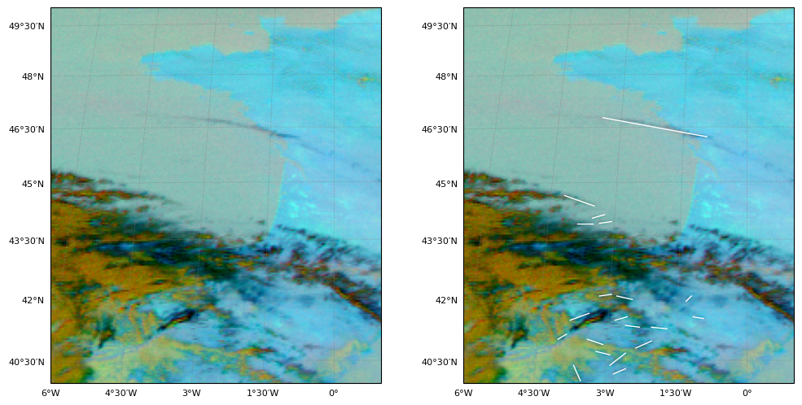

Slide 4
